Slide 1
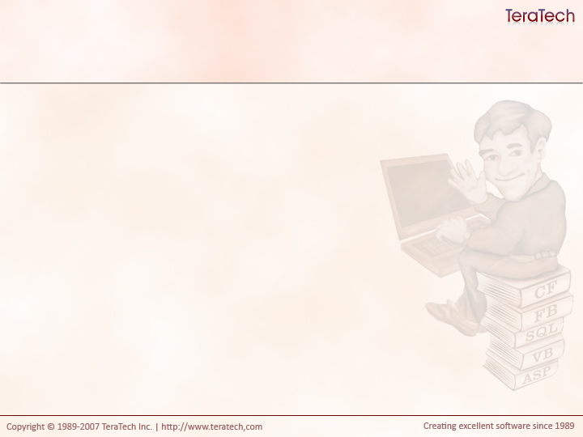
The Model-Glue Framework
An HTML Presentation Framework

Slide 2
A Framework’s Purposes
Structure
  Enforces a common architecture
Standards
  Provides a set of rules for developers in team environments
Notes:
Show Model-Glue version of Fortune app

Slide 3
The Request Model
All requests routed through index.cfm
  The Front Controller Design Pattern
“event” URL argument used to tell the framework what code to execute
  http://localhost/index.cfm?event=DoSomething
Application does what it’s configured to
Similar to both Mach-II and Fusebox

Slide 4
Application.cfm
Used to set the application name and session support
Don’t put anything else in here
Notes:
Show Fortune application.cfm

Slide 5
Index.cfm
Sets various values needed to load the framework
ModelGlue_APP_KEY
  The name of the element where Model-Glue will be in the application scope.
  Used when multiple applications exist in the same application name.
ModelGlue_LOCAL_COLDSPRING_PATH
  The path to the ColdSpring configuration file
  Could be used to move configuration out of the webroot.
Includes the Model-Glue core framework
Notes:
Show fortune Index.cfm and default Index.cfm

Slide 6
Important Folders
/Config
  This is where Model-Glue and ColdSpring’s configuration files are put
/Controller
  This is where your controllers will be placed
  Template provides a starting point
/Views
  This is where your CFM view files will be placed
  Template provides two views
/Model
  This is where your application’s CFC model will be placed
  Template provides nothing (really)
All of these folders can be moved out of the webroot.
You don’t need the Reactor or Transfer folders provided by the Template

Slide 7
Model-Glue’s Configuration
/config/ModelGlue.xml by default
  This Path set in the ColdSpring.xml.
Model-Glue is configured using XML

Slide 8
The Basic Model-Glue.xml Structure
<modelglue> (only one)
  <controllers> (only one)
    <controller> (one or more)
      <message-listener> (one or more)
  <event-handlers> (only one)
    <event-handler> (many)
      <broadcasts> (zero or more)
      <views> (zero or more)
      <results> (zero or more)
Notes:
Review my Model-Glue fortune application to show off some of these tags.
Try to get the students to tell me where to find the code that’s being executed.

Slide 9
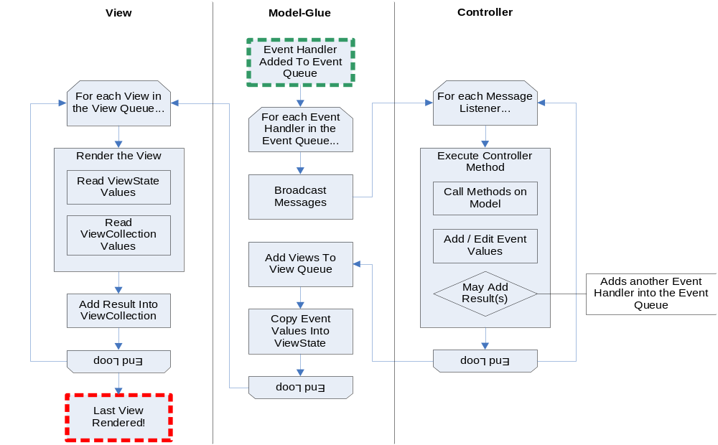
Request Flow

Slide 10
Event Handlers
Denoted by the <event-handler> tag.
Roughly equivalent to a “page”.
Requested by event url argument.
Implicitly does “stuff” via broadcast messages
Branches via results
Display “stuff” via views
Notes:
Explain that stuff is done implicitly by broadcasting messages (like the baby’s cry)
Explain that results are messages that can be set by the controller that result in other events being queued.
Explain that data is passed to views

Slide 11
Broadcast Messages
Denoted by <message> tags collected under a <broadcasts> tag.
Messages are “shouted out” by ColdFusion and are “listened for” by “message listeners”.
  These map to methods on your controllers
  More than one listener can listen for a message
Implicit Invocation…
  Think about crying babies.

Slide 12
Message Listeners
Denoted by <message-listener> tags collected under a <controller> tag.
Relates messages to methods in a controller.
Implicit Invocation…
  Think about the parents doing things to make the baby stop crying.

Slide 13
Results
Denoted by <result> tags collected under <results> tag.
Results can be “added” by controllers
Tag maps results to Event Handlers

Slide 14
Views
Denoted by <include> tags collected under <views> tag.
Similar to cfinclude
Render view into ViewCollection
Last view sent to the browser

Slide 15
The Event Object
Holds form and URL variables
  Form has precedence by default
Controller can manipulate values in the ViewState.
Exists while event handlers are being executed

Slide 16
The ViewState Object
Populated from the Event Object
Exists while views are being processed

Slide 17
The ViewCollection
As views are displayed they’re added into the ViewCollection
Other views can get rendered views from the ViewCollection

Slide 18
Request Flow

Slide 19
Exercise: Be Model-Glue
Let’s do the translator exercise again…

Slide 20
The Event API (Abridged)
Event.setValue(name, value)
  Returns nothing
Event.getValue(name, default)
  Returns any type
Event.valueExists(name)
  Returns boolean
Event.getAllValues()
  Returns a Struct

Slide 21
The ViewState API (Abridged)
ViewState.getValue(name, default)
  Returns any value
ViewState.exists(name)
  Returns a boolean

Slide 22
The ViewCollection API (Abbriged)
ViewCollection.getView(name)
  Returns a string of HTML
ViewCollection.exists(name)
  Returns a boolean

Slide 23
Gotcha!
Getting a value that doesn’t exist without a default creates the value and sets it to an empty string!
  True for Event and ViewState
  Not true for ViewCollection (but it does return an empty string
Calling exists after getting a value that doesn’t exist will return true!

Slide 24
Exercise: Make a Model-Glue Application
Using the CFC you created earlier create the same Fortune application as you did in the first exercise.
Apply a common design template

Slide 25
Let’s Talk
What was difficult in this exercise?
What was easy?
Do you think this will ever take you less time to write?
What do you think you’ll get out of this?
If you had to choose a structured framework or procedural code, which would would you choose right now?

